Slide 1



Machine Learning Project
Presented by:
Ankita Kallurwar
Batch: CDF Feb2019

Slide 2

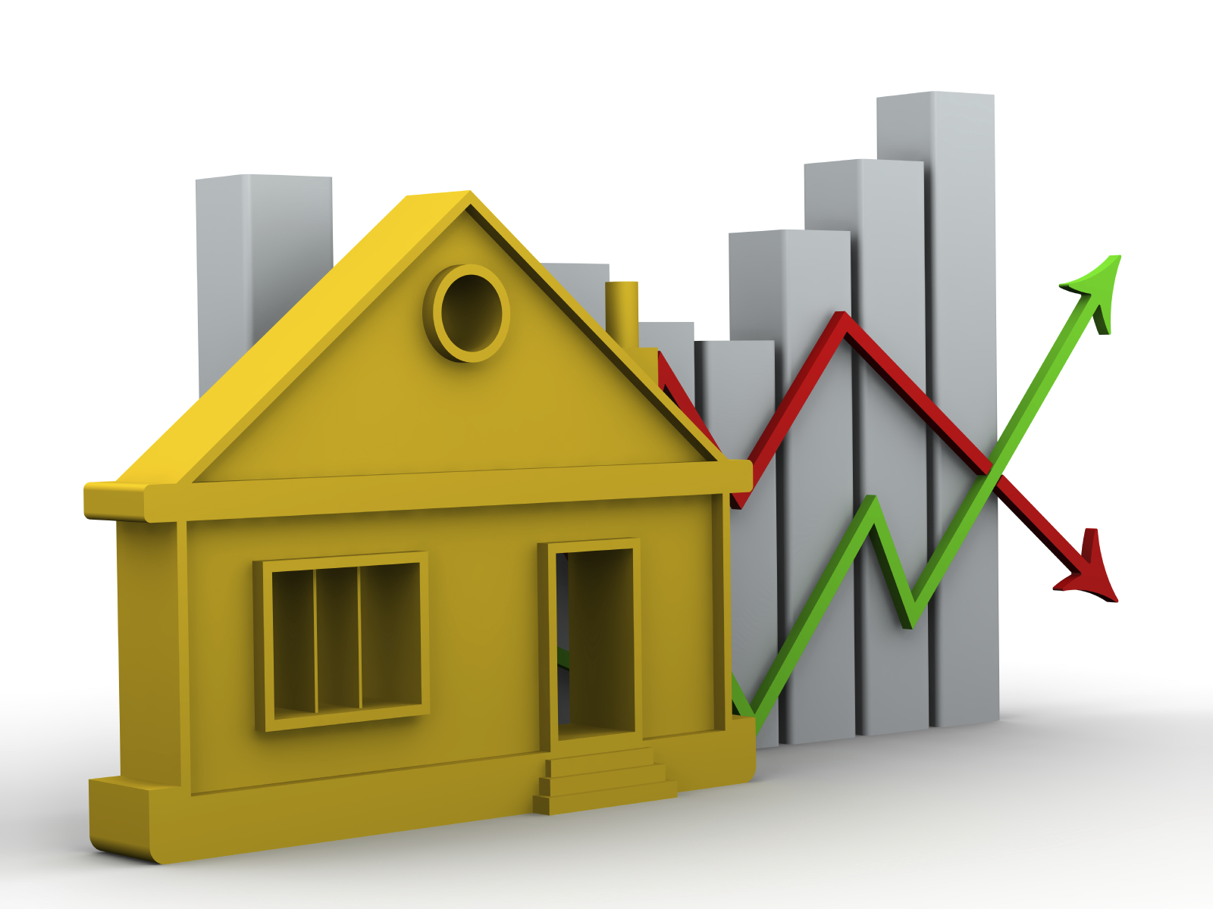

Slide 3
Table of Contents:
Introduction
About Dataset
Analyzing the Test Variable (Sale Price)
Correlation between the attributes
Missing Data Imputation
Exploratory Data Analysis
Modeling
Conclusion

Slide 4

Introduction
This presentation is going to be focused on solving the problem of predicting house prices for house buyers and house sellers.
Goal of this project is to use regression techniques in order to estimate the sale price of a house given the features and pricing data for 1460 houses

Slide 5


About Dataset
This data set has several features related to respective houses. SalePrice is the target variable (y) and using rest of the features as Independent variables (x).
It contains 1460 data points and 82 features that help predict the selling price of a house.
Total we have 82 features in which 81 are given & 1 is derived from sale price by getting the log transformation of the same and I am planning to use 10 attributes which are important as per business sense.
There are two types of features in housing data, categorical and numerical.
- Categorical data is in categories. It is not necessarily linear, but it follows some kind of pattern.
- Numerical data is data in number form. These features are in a linear relationship with each other.
There are 43 categorical variables and 39 numerical variables in the data means total 82 features

Slide 6
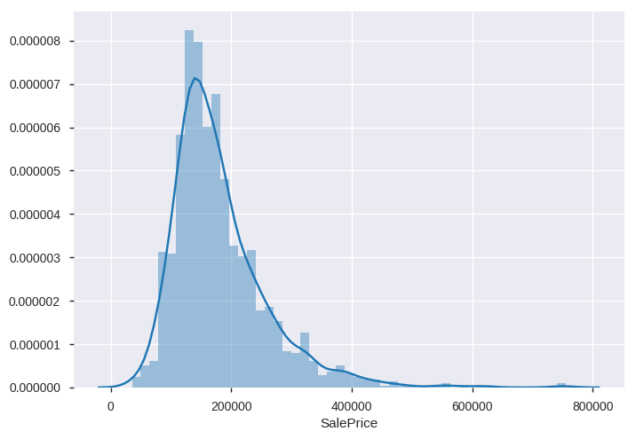
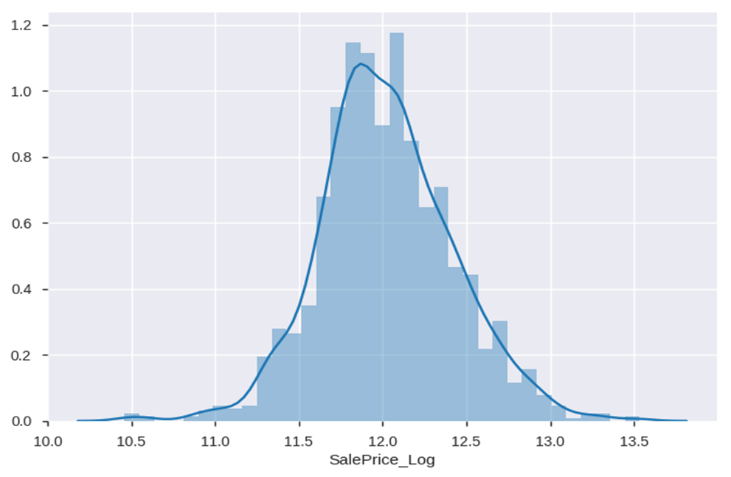
Analyzing the test variable (SalePrice)
Most of the density lies between 100k and 250k, and outliers appears on the costlier side.
From the graph, we can see that the data:
Deviate from the normal distribution
Have appreciable positive skewness.
Showing higher peak.
This can reduce the performance of the ML regression models because some assume normal distribution,
Log transformation of SalePrice
Now the resulting distribution looks much better to analyze it further.

Slide 7
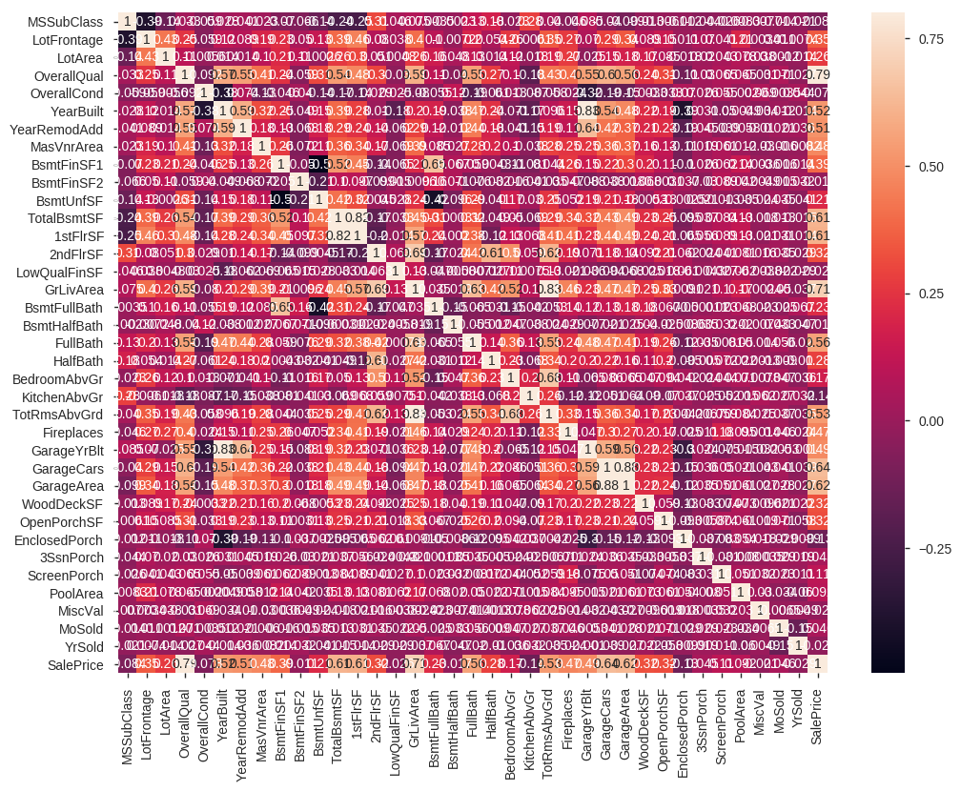
Correlation between the attributes
We can see the highly correlated variables
The first one refers to the 'TotalBsmtSF' and '1stFlrSF' variables
The second one refers to the 'GarageCars' and 'GarageArea' variables.
Both cases show how significant the correlation is between these variables

Slide 8
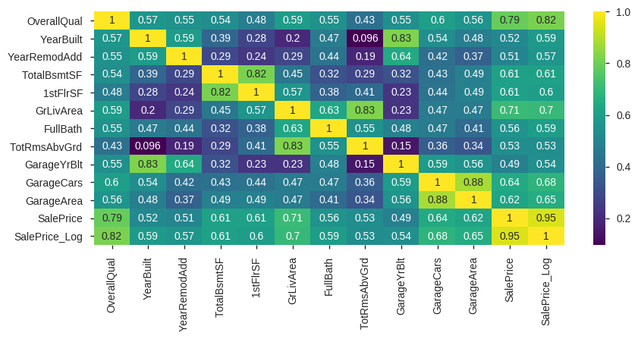
“SalePrice” correlation
From the matrix, we can see that:
‘OverallQual’ is highly correlated with target feature of Saleprice by 82%
‘GarageCars’ and ‘GarageArea’ are also some of the most strongly correlated variables. The number of cars that fit into the garage depends on the garage area.
'GrLivArea' and 'TotalBsmtSF' are strongly correlated with 'SalePrice'
'TotalBsmtSF' and '1stFlrSF' are strongly correlated with each other.
'TotRmsAbvGrd' and 'GrLivArea' are also strongly correlated with each other.
'YearBuilt' and 'GarageYrBlt' are strongly correlated to each other.

Slide 9
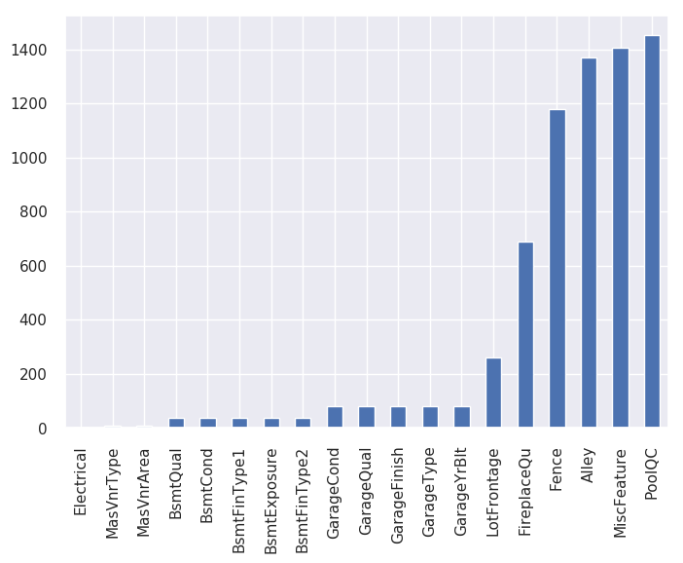
Missing value imputation
Missing values in the data set can affect prediction of a model negatively.
According to data:
- There are 19 attributes which have missing values,
- In few columns there is lots of NaN entries. However, reading the data description we find this is not missing data.
- Like for PoolQC, NaN is not missing data but it means no pool in that particular house, likewise for all other variables.
- For ex. Fence has got 1179 null values. We can safely assume that those houses doesn't have a Fence and replace those values with None

Slide 10
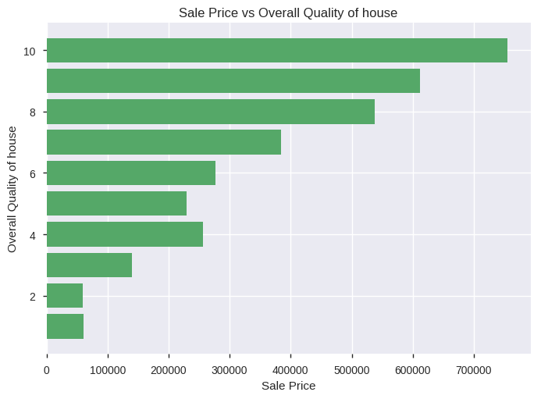
Questions
1. How Overall Quality related to SalePrice?
From the graph, we can see that
Overall Quality is positively correlated to SalePrice.
As Overall Quality getting better, the SalePrice increases.

Slide 11
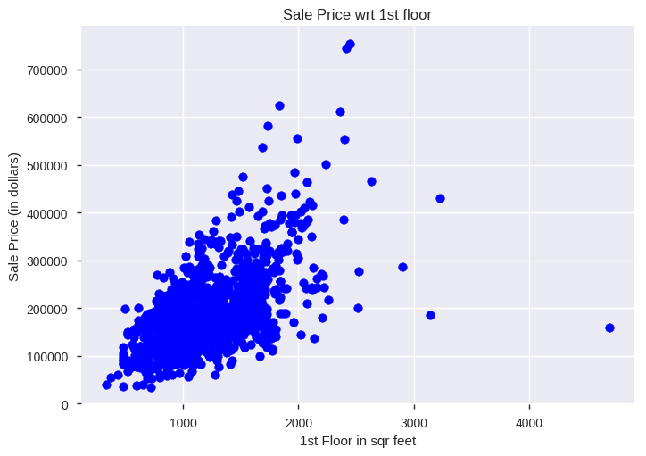
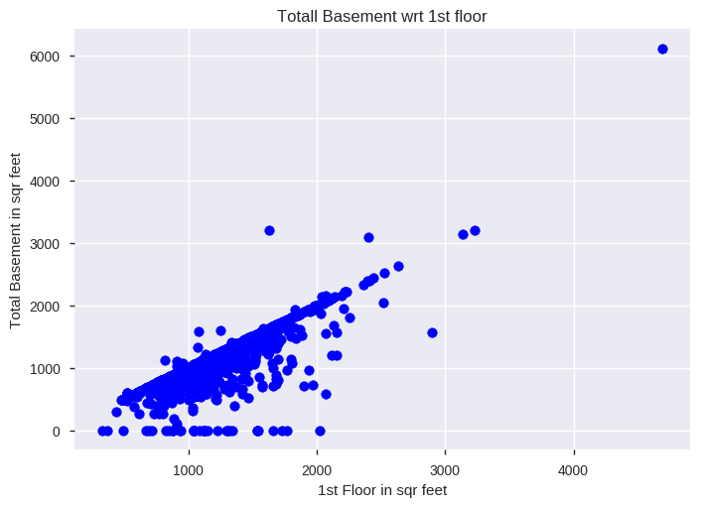
2. How the variable 1st Floor in square feet is related to Sale Price?
Analyzing Total Basement and 1st floor correlated to each other
1st floor in sqr ft is in linear relationship with each other

Slide 12
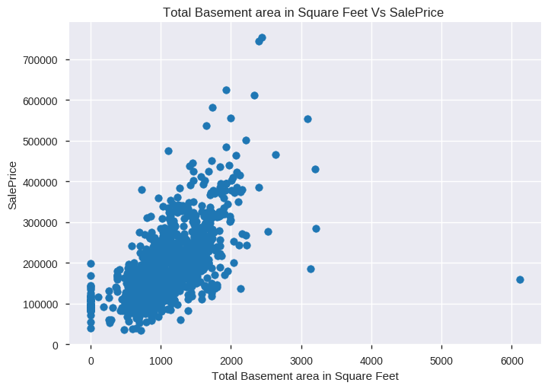
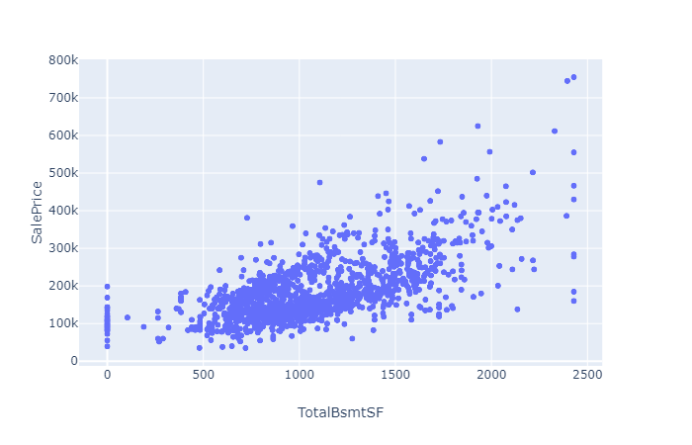
3. How Total Basement and Sale price are related?
Outlier removal:
There are certain outliers in the data, so it is necessary to remove them to get better distribution of the data.
From the above data, we can see that
- The outliers with high Total basement area( more than 6000 SF) have very less saleprice (approx 180000)got removed.
- Some other outliers are also get removed by this process.

Slide 13
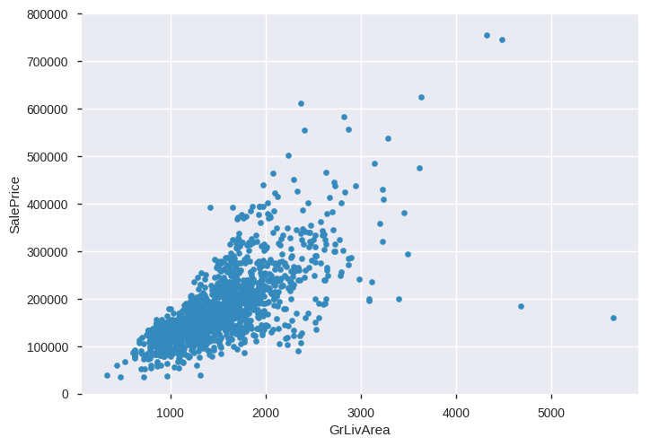
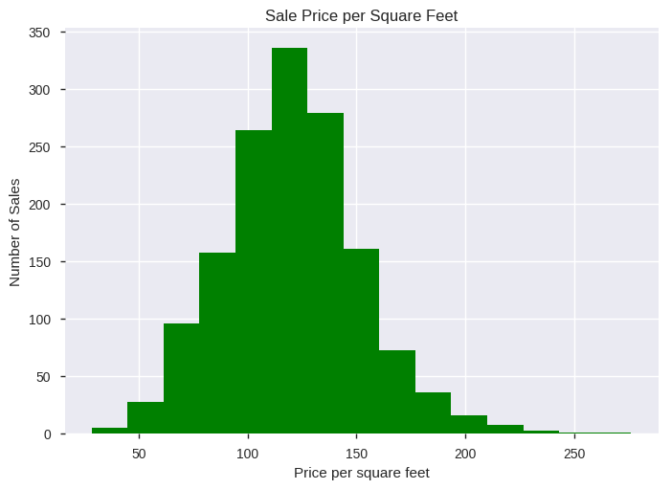
4. How the variable Ground living area related to sale price?
We can calculate SalePrice per square feet
From the above graph, we can see that,
Ground living area is in positive relationship with sale price.
As per above graph, we would be able to calculate Average Sale Price per square feet ie. $ 120.5728

Slide 14
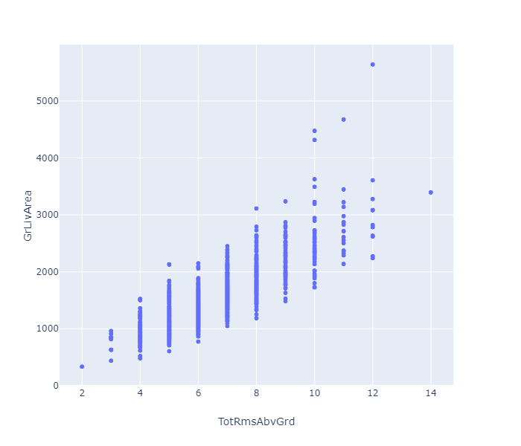
5. Relationship between Ground living area and Total rooms above grade
From the graph, we can see that
Total rooms above grade and ground living area are positively correlated to each other.

Slide 15
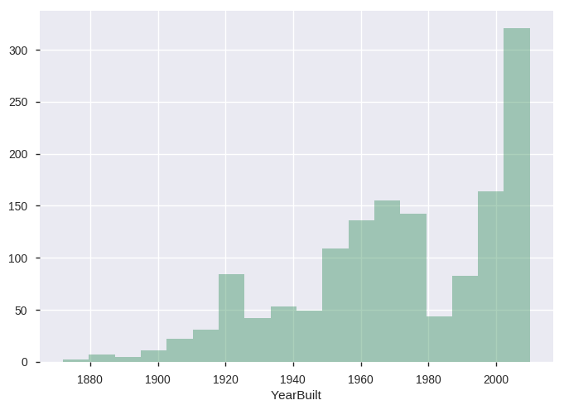
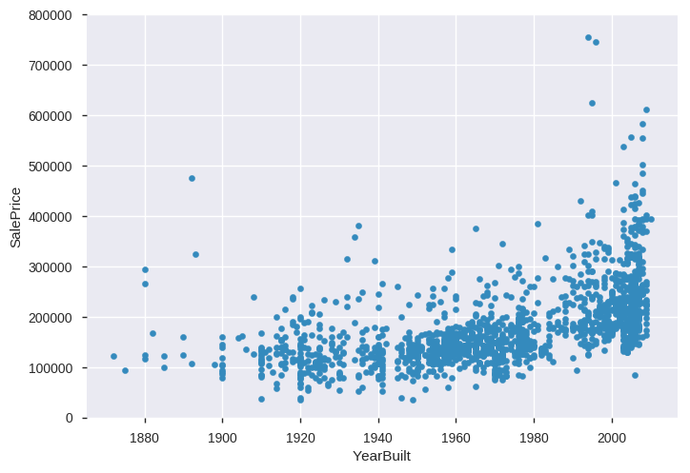
6. How Year Built related to sales price?
Analyzing "YearBuilt" with respect to "SalePrice"
From the above graph, we can say that
Number of houses building is increasing year by year.
The maximum number of houses built is 67.
From the above graph, we can see that
Year Built and sale price are negatively correlated.
Price of house is getting down with its age.

Slide 16
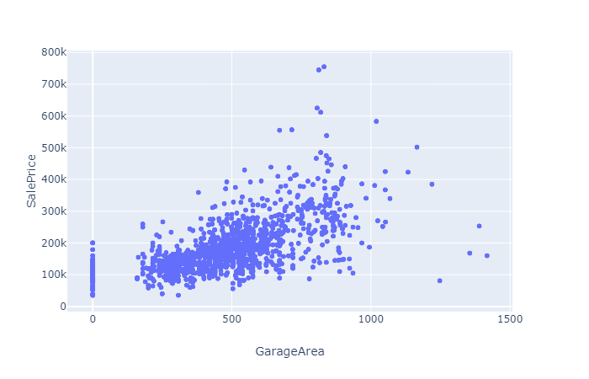
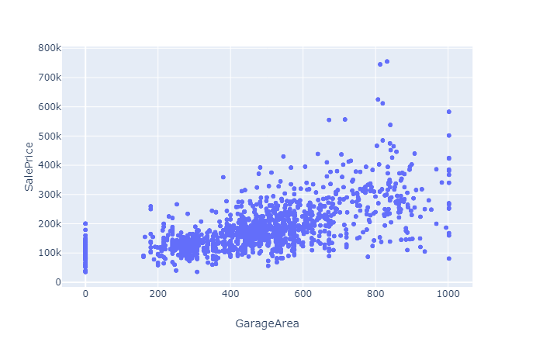
7. How garage area is related to sale price?
Outlier Removal
From the above graph, we can see that,
- Garage area and SalePrice are in linear relationship with each other.
- As the garage area increases, the saleprice of the house also increases.
- Even we can see that some houses does not have Garage area.
From the above graph, we can see that, the outliers has been removed an the distribution is looking better.

Slide 17
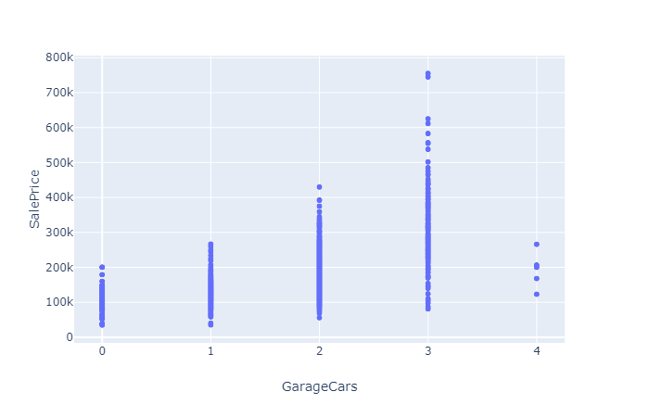
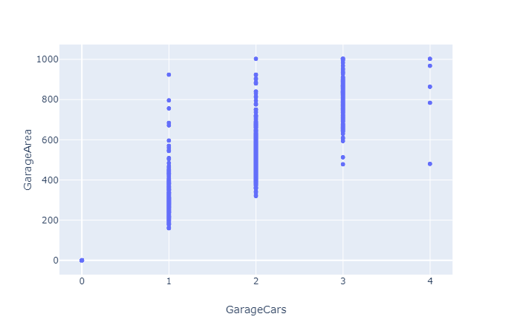
8. How Garage Cars related to Sale price?
Analyzing the relationship between Garage Area and Garage cars
From the above graph, We can say that
As the number of Garage cars increases, the sale rice also increasing
From the above graph, we can see that
- Garage area and Garage cars are positively correlated to each other.
- As garage area increases,the number of garage cars also increasing.

Slide 18
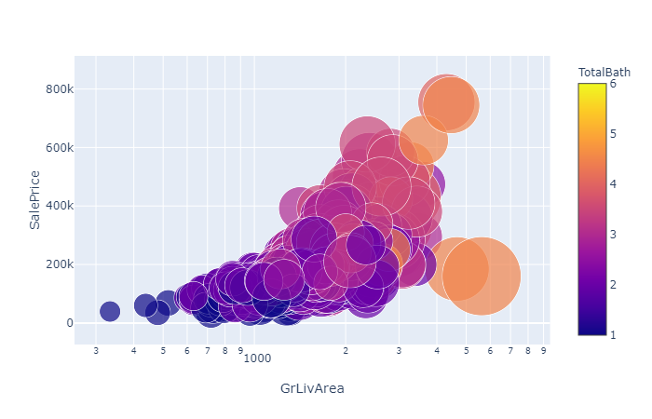
9. How total number of bathrooms impact the sale price of the house?
From the graph,
We can check all the details of particular house like whether the house has full bath or half bath, Ground living area,1st Floor SF, Garage area, Total basement area in SF and Sale price of the house.

Slide 19
Modeling

Slide 20
Best Model
Decision Tree

Slide 21
Conclusion
We have 80 features in the data, but i would be considering only 10 important features for our analysis as per business sense.
According to the correlation, some features have high correlation with the class variable ie Sale price and those features are Overall Quality, Ground living area, Total basement area, Garage Cars and Garage Area etc
As per EDA, we can conclude that, correlation shift with change of Sale price. For example, we can see that Overall Quality is highly correlated to Sale Price means sale price is highly dependent on the overall quality of the house. Overall Quality rates the overall material and finish of the house (1 = Very Poor, 10 = Very Excellent).
For the prediction, we applied modeling algorithms like Linear regression, Decision Tree & Random Forest to the data and from the modeling we can conclude that, Decision tree is the best model for the prediction of Sale price of the house because of following reasons:
Its the Quickest
It is explainable compare to Random Forest.
If we can see the RMSE, its the lowest means it is more accurate than the rest.

Slide 22



